Slide 1
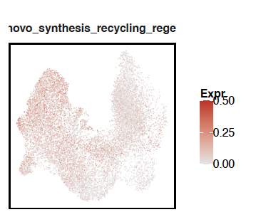
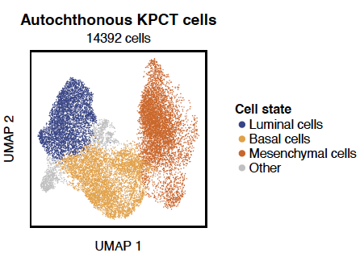
A
B
Human breast scRNA-seq
(source et al?)
C
Human breast TCGA bulk RNA-seq
(source et al?)
Differentiated
state(s)
Intermediate
Plasticity associated
state(s)
Dedifferentiated /
mesenchymal-like
state(s)
BH4 pathway transcriptional score
(de novo synthesis & recycling genes)
BH4-pathway score
BH4-pathway score
Human scRNA-seq & bulk transcriptomic data analysis
Breast | PDAC | Melanoma | Neuroblastoma
Epithelial
(E)
Hybrid
(E/M)
Epithelial
(E)
Hybrid
(E/M)
Mesenchymal
(M)
Mesenchymal
(M)
D
E
F
G
Autochthonous KPCT PDAC
scRNA-seq
Mouse PDAC scRNA-seq
Human PDAC scRNA-seq
(Cohort I- source et al?)
Human PDAC scRNA-seq
(Cohort 2 - source et al?)
BH4-pathway score
BH4-pathway score
BH4-pathway score
Classical
basal
Mesenchymal
Classical
IC
Mesenchymal
Classical
IC
Mesenchymal
H
I
J
K
Human melanoma scRNA-seq
(using Tirosh MITF-AXL continuum)
Human melanoma scRNA-seq
(using Tsoi 4-state trajectory)
Human neuroblastoma bulk
(Cohort 1 - source et al?)
Human neuroblastoma bulk
(Cohort 2 - source et al?)
BH4-pathway score
Pending
BH4-pathway score
Pending
BH4-pathway score
BH4-pathway score
MITF-AXL score
Melanocytic
Transitory
Neural
crest-like
Undifferentiated
MES-ADRN score
MES-ADRN score

